Slide 1

HEART DISEASE PREDICTION using MACHINE LEARNING
By
Mohan kandregula – 20031J0006
Bhagath naidu – 20031J0026
Alekhya bommakanti – 20031J0023
Monika vadlamanu – 20031J0052
Under the guidance of
Mohan krishna sir (HOD MSIT)

Slide 2
TABLE OF CONTENTS:
S. No. | CONTENT
1. | ABSTRACT
2. | LITERATURE SURVEY
3. | PROBLEM DEFINITION
4. | SOLUTION STRATERGY
5. | METHODOLOGY
6. | IMPLEMENTATION
7. | RESULTS
8. | CONCLUSION

Slide 3
ABSTRACT:
Machine learning can be used to predict the Heart Disease.
Heart Disease dataset has some non-linear tendency.
Improvement on Heart Disease Prediction technique by correctly adjusting the Random Forest Machine Learning Model (fetching 85.81% accuracy).
Health care data contains hidden information which is useful for making effective decisions.
This can help patients in getting a quick diagnosis with a lot less cost.

Slide 4
LITERATURE SURVEY:
S.No. | Name of Paper | Author | Methodology | Limitations
1. | An Artificial Neural Network Model for Neonatal Disease Diagnosis | Dilip Roy Chowdhury, Mridula Chatterjee, R.K. Samanta | Multi-Layered Perceptron | They used 94 attributes(which is a great number) to train the NN which gives a lesser accuracy of 75%
2. | Comparative Study of Data Mining Classification Methods in Cardiovascular Disease Prediction | Milan Kumari, Sunila Godara | Decision Tree, Artificial Neural Network | Accuracy was closer to 80 % which could be improved
3. | Decision Support System for Heart Disease Diagnosis using Neural Network | Niti Guru, Anil Dahiya, Navin Rajpal | Neural Network | Only 78 instances were used to train neural network which tends to be less effective.
etc.

Slide 5
PROBLEM DEFINITION:
WHO has estimated that 12 million deaths occur worldwide, where heart disease is the major cause of deaths.
Millions of health related data being generated every day which is difficult to be analyzed.
Huge amount of time and cost is required to detect heart disease.
“To build a Heart Disease prediction system to overcome the shortcomings of the prior Heart Disease detection techniques.”

Slide 6
SOLUTION STRATEGY:
Collect a dataset for Heart Disease prediction.
Select the dependent attributes from the total number of attributes.
Preprocess the dataset.
Apply Machine Learning algorithms according to the nature of dataset.
Cross-validate the algorithms accuracy.

Slide 7
METHODOLOGY:
Machine learning algorithms used (using sklearn library of python):
Linear Regression
Logistic Regression
Support Vector Machine
Decision Tree
Random Forest
Cross Validation Techniques used:
3-fold
5-fold
10-fold

Slide 8
IMPLEMENTATION:
Start
Get dataset
Create training set and testing set
Preprocess dataset
(replace missing value, etc.)
Apply Supervised Learning Algorithm
Analyze dataset for different type of Machine Learning Algorithm
Do cross-validation
Show the accuracy
No
If supervised
?
Yes
Stop
Fig 1 : Flow Chart of implementation

Slide 9
IMPLEMENTATION DETAILS (steps):-
Start
Collect the dataset.
Select the dependent attribute.
Preprocess the data.
Analyze dataset for different type of machine learning algorithm.
If supervised :
6.1. Create training set and testing set using 10-fold cross-validation.
6.2. Apply supervised learning algorithm.
6.3 Do testing using the test set.
6.4. Show the accuracy.
7. Stop

Slide 10
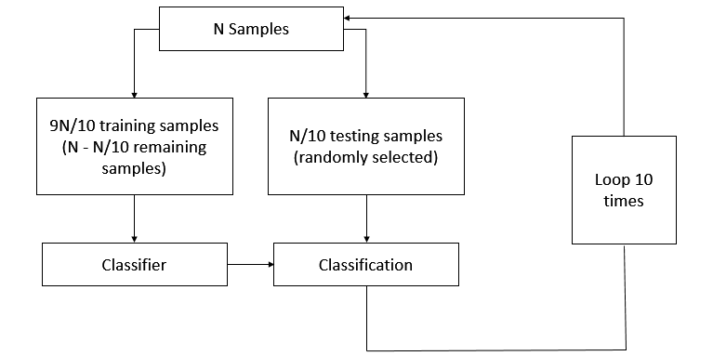
VALIDATION TECHNIQUE :
Fig 3: Block diagram of 10-fold cross validation

Slide 11
10-FOLD CROSS VALIDATION:
Data points of 303 instances are randomly assigned to 10 sets (approximately 30 instance in each dataset) d₀, d₁,…, d₉ so that all the 10 sets are equal in size.
We then train on d₀, d₁,…, d₈ and test on d₉, train on d₀, d₁,..., d₉ (except d₈) and test on d₈ , similarly followed by testing every single set.
Iteration No. | Training Set | Testing Set
1. | d₁,d₂,d₃,d₄,d₅,d₆,d₇,d₈,d₉ | d₀
2. | d₀,d₂,d₃,d₄,d₅,d₆,d₇,d₈,d₉ | d₁
3. | d₀,d₁,d₃,d₄,d₅,d₆,d₇,d₈,d₉ | d₂
4. | d₀,d₁,d₂,d₄,d₅,d₆,d₇,d₈,d₉ | d₃
5. | d₀,d₁,d₂,d₃,d₅,d₆,d₇,d₈,d₉ | d₄
6. | d₀,d₁,d₂,d₃,d₄,d₆,d₇,d₈,d₉ | d₅
7. | d₀,d₁,d₂,d₃,d₄,d₅,d₇,d₈,d₉ | d₆
8. | d₀,d₁,d₂,d₃,d₄,d₅,d₆,d₈,d₉ | d₇
9. | d₀,d₁,d₂,d₃,d₄,d₅,d₆,d₇,d₉ | d₈
10. | d₀,d₁,d₂,d₃,d₄,d₅,d₆,d₇,d₈ | d₉

Slide 12
ATTRIBUTES USED:
The dataset have 76 raw attributes, only of them are actually used. The attributes used are :
Age : age in years
Sex : sex (1 = male; 0 = female)
Cp : Chest Pain Type
Value 1: typical angina
Value 2: atypical angina
Value 3: non‐anginal pain
Value 4: asymptomatic
Trestbps : Resting blood pressure (in mm Hg on admission to the hospital)
Chol : serum cholestoral in mg/dl
Fbs : (fasting blood sugar > 120 mg/dl) (1 = true; 0 = false)
Thalach : maximum heart rate achieved

Slide 13
Restecg : resting electrocardiographic results
Value 0: normal
Value 1: having ST‐T wave abnormality (T wave inversions and/or ST elevation or depression of > 0.05 mV)
Value 2: showing probable or definite left ventricular hypertrophy by Estes' criteria
Exang : exercise induced angina (1 = yes; 0 = no)
Num : diagnosis of heart disease (angiographic disease status)
Value 0: < 50% diameter narrowing
Value 1: > 50% diameter narrowing

Slide 14
RESULTS

Slide 15
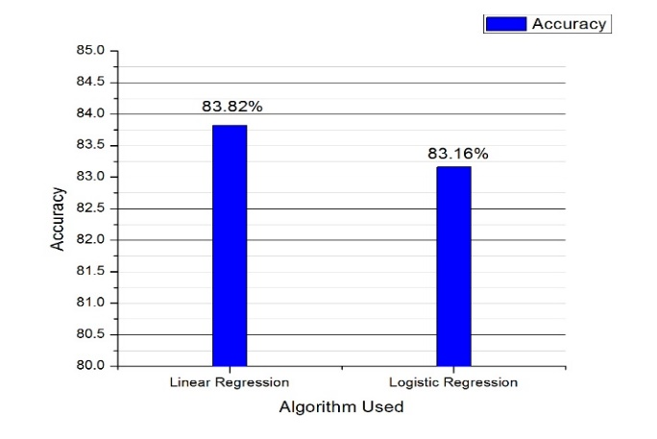
LINEAR DEPENDENCY:
Fig 8: Comparison of Linear Regression with Logistic Regression

Slide 16
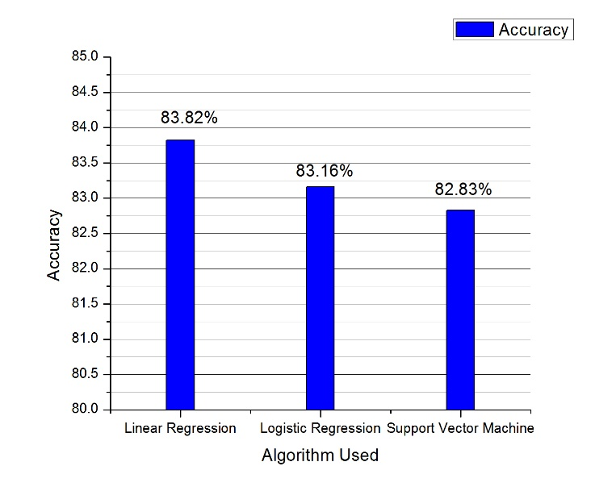
LINEAR DEPENDENCY:
Fig 8: Comparison of Linear Regression, Logistic Regression and SVM showing decrease in accuracy

Slide 17
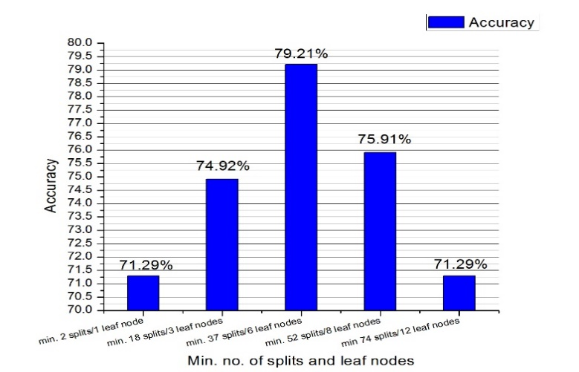
DECISION TREE:
Fig 9: Accuracy obtained by varying parameters in Decision Tree

Slide 18
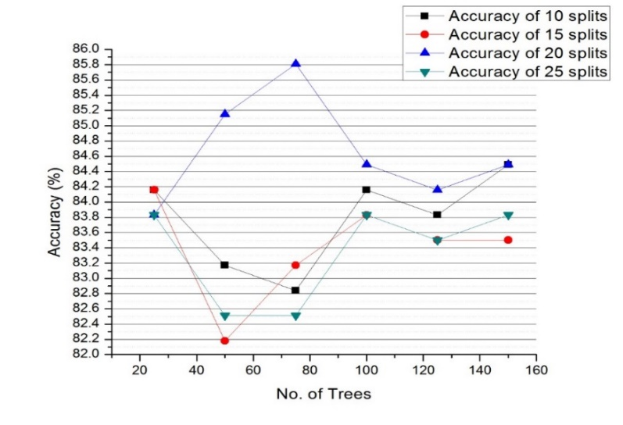
RANDOM FOREST:
Fig 10: Accuracy achieved with variable number of Splits and Trees

Slide 19
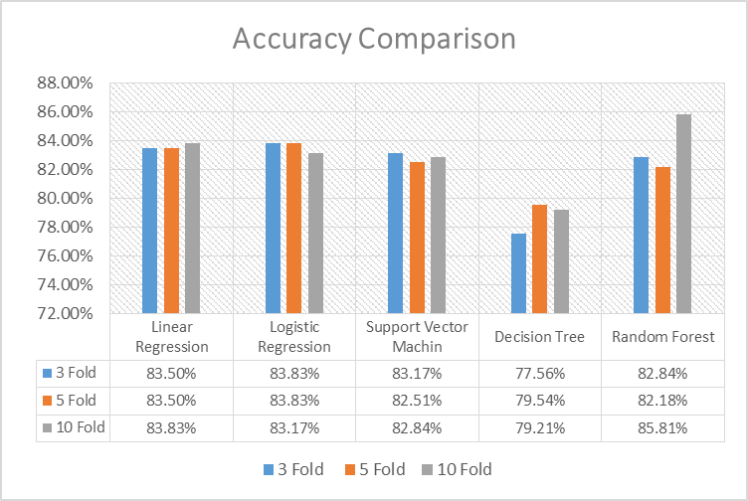
COMPARISON:
Fig 11: Comparison of result with different validation
technique

Slide 20
CONCLUSION:
Our dataset set had Non-Linear dependency.
By correctly adjusting the parameters of Random Forest we were able to achieve better accuracy.
We had lesser amount of dataset so 10-fold cross-validation gave us better result.
Our solution strategy is not so Robust in nature, every time it needs a few adjustment in parameter.
The accuracy achieved is satisfactory but can be future improved.
We can use data warehouses in hospital so that the amount of data increases and a greater accuracy could be achieved.

Slide 21
THANK YOU!!

